Slide 1

WEB SCRAPING TO GAIN COMPANY INSIGHTS
19/11/2022

Slide 2
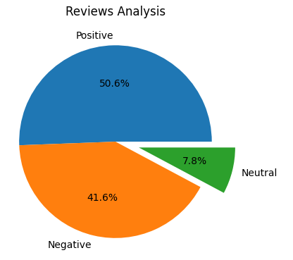
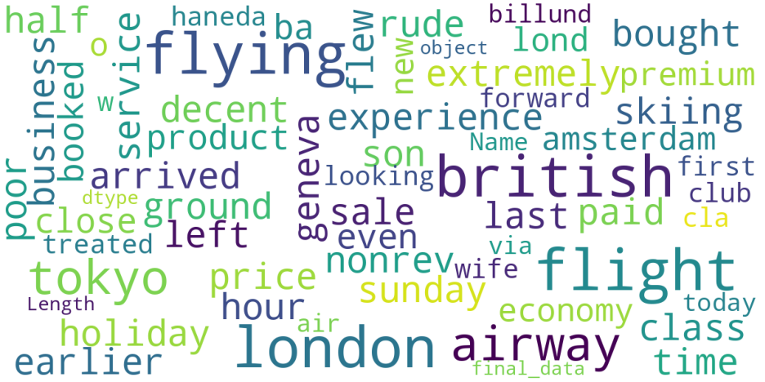
INSIGHTS FROM CUSTOMER REVIEWS
From cleaning 1000 reviews given by the customers, we obtained
Positive Reviews - 506
Negative Reviews - 416
Neutral Reviews – 78
Word cloud of keywords used in reviews

